Slide 1
The Global SDG indicators process and fao’s role in support to countries
Dorian Kalamvrezos Navarro
Programme Advisor, FAO Office of the Chief Statistician

Slide 2
the Global SDG INDICATOR framework
The 2030 Agenda for Sustainable Development will guide the actions of governments, international agencies, civil society and other institutions over the next 15 years
UN Statistical Commission responsible for developing the SDG monitoring framework
Inter-Agency Expert Group on SDG indicators (IAEG-SDG) to prepare an initial proposal and oversee this work through to 2030
28 countries as members, representing regions; International organizations only as observers
Notes:
the General Assembly in September 2014 assigned the task of identifying the list of global SDG indicators to the UN Statistical Commission, on the basis of the consensus that it should not be politically negotiated but selected instead by technical experts.
The UN Statistical Commission is the apex intergovernmental body for the global statistical system, bringing together the Chief Statisticians of member states and international organizations with the objective of setting international statistical standards and supporting their implementation at the national and international levels.
The 2030 Agenda for Sustainable Development will guide the actions of governments, international agencies, civil society and other institutions over the next 15 years
To measure progress against the SDGs and their targets, the UN Statistical Commission has been given the responsibility of developing the SDG monitoring framework
It established the Inter-Agency Expert Group on SDG indicators (IAEG-SDG) to prepare an initial proposal and oversee this work through to 2030
28 countries as members, representing their respective regions; International organizations participate as observers; the UN Statistical Division hosts the Secretariat
A list of 230 global SDG indicators was approved by the 47th UN Statistical Commission (March 2016) “as a practical starting point” to monitor the 169 targets
The UN Statistical Commission requested the IAEG-SDG to continue refining the global indicators

Slide 3
The 48th un Statistical Commission (March 2017):
Agreed with the refined global indicator framework (GIF) comprising 232 unique indicators;
Agreed with the IAEG-SDG’s proposed plan for annual refinements and for two comprehensive reviews of the indicators in 2020 and 2025;
Urged the IAEG-SDG to accelerate the methodological development of Tier III indicators;
Recognized the valuable role of custodian agencies in global reporting and recommended them to increase their capacity building and technical assistance efforts;
The global indicator framework was adopted by ECOSOC (June 7th) and is expected to be endorsed by the UN General Assembly in September.

Slide 4
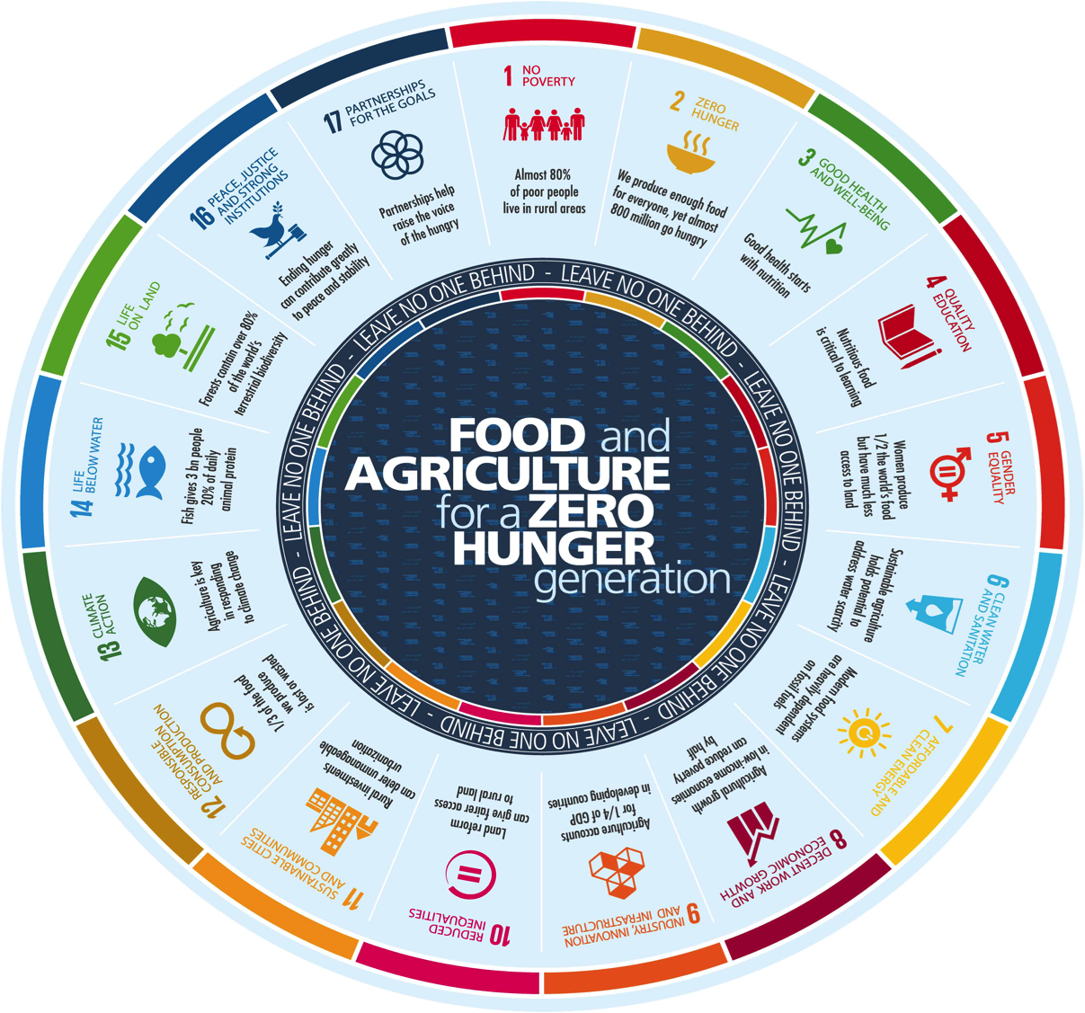
The role of custodian agencies
For each indicator a custodian agency has been identified responsible for:
collecting data from national sources, ensuring their comparability and consistency, and disseminating them at global level
further methodological development and documentation of the indicators
statistical capacity development of countries to generate and disseminate national data
contributing to monitor progress at the global, regional and national levels
Notes:
contributing to monitor progress at the global, regional and national levels: (e.g. storyline for the annual SDG report)

Slide 5
main decisions to date on Global reporting
Global versus national or thematic indicators
Global indicators as a core set of metrics that all countries are invited to monitor (classified in three Tier according to methodological development and data availability)
Global indicators can be complemented with national or thematic indicators (par. 75 of the UN resolution on the 2030 Agenda)
Global reporting mechanism
International organizations responsible for collecting national data, harmonizing them, aggregating them at regional and global level and transmitting them to the IAEG-SDG Secretariat
Global monitoring is based on data produced by countries, with NSOs having a key coordinating role at national level. If estimates produced by international organizations, prior consultation with countries before publication
Notes:
Global versus national or thematic indicators
Global indicators as core set of metrics that all countries are invited to monitor – National Statistical Offices (NSOs) will have a key role in coordinating SDG reporting at country level
Global indicators can be complemented with national or thematic indicators; but alignment of national and global indicators in the best interest of countries
Global reporting mechanism
International organizations responsible for collecting national data, harmonizing them, aggregating them at regional and global level and transmitting them to the IAEG-SDG Secretariat
In general, global monitoring based on data produced by countries. If estimates produced by international Organizations, prior consultation with countries before publication
Review of the global indicator framework
A list of 36 additional indicators will be submitted for open consultation in April 2017
Two comprehensive ‘reviews’ scheduled for 2020 and 2025. These comprehensive reviews could imply substantive changes to the list of global indicators, including addition, deletion, replacement.

Slide 6
The 5th IAEG-SDG (March 2017):
Encouraged custodian agencies to accelerate the work on Tier III indicators
Approved the upgrade of four out of eleven Tier III indicators that applied to move to the Tier II category, thus enabling global reporting to begin.
For FAO, approved the upgrade of two Tier III indicators: the indicator of food price anomalies (2.c.1) and of women’s access to land (5.a.1).
Advised on the timeline for Tier category upgrades (autumn 2017-2018)
Presented new criteria for upgrading Tier III indicators: regionally representative pilot testing; information on NSOs’ involvement; draft metadata; information on governing bodies approval of new international standards;

Slide 7
Status of SDG indicators under FAO custodianship as of April 2017
FAO as custodian agency (21 indicators)
Goal | Indicators
Goal 2 (Food security, Nutrition, Sustainable Agriculture) | 2.1.1 | 2.1.2 | 2.3.1 | 2.3.2 | 2.4.1 | 2.5.1 | 2.5.2 | 2.a.1 | 2.c.1
Goal 5 (Gender equality) | 5.a.1 | 5.a.2
Goal 6 (Use of Water) | 6.4.1 | 6.4.2
Goal 12 (Sustainable Consumption and Production) | 12.3.1
Goal 14 (Oceans) | 14.4.1 | 14.6.1 | 14.7.1 | 14.b.1
Goal 15 (Life on Land) | 15.1.1 | 15.2.1 | 15.4.2
TIER | LEVEL OF DEVELOPMENT
I | Established methodology exists and data already widely available
II | Methodology established but data not easily available (>50% country coverage)
III | Internationally agreed methodology not yet developed, data largely unavailable

Slide 8
FAO key immediate priorities:
Accelerate the work on Tier III indicator in order to upgrade all the remaining indicators (8) at the next IAEG-SDG session in October 2017.
Intensify statistical capacity development support across all 21 SDG indicators.
Advise countries on aligning their national monitoring framework to the SDG indicators and assisting in data gap analyses.

Slide 9
FAO’s work on SDG indicator methodologies
In some cases, no internationally agreed operational definition, for example:
Definition of small-scale producer (indicators 2.3.1 and 2.3.2)
Definition of agricultural sustainability (indicators 2.4.1)
Definition of rural/urban areas (most SDG indicators)
In other cases, an internationally agreed methodology, has not yet been developed (e.g. indicators 5.a.2, 12.3.1)
In response, FAO is developing new methodological proposals and survey tools, and is also organizing expert meetings, pilot tests, and country consultations
Notes:
At the end of January 2017, FAO submitted updated workplans for the 11 Tier III category indicators under its custodianship
In some cases, no internationally agreed definition, for example:
Definition of smallholder (indicators 2.3.1 and 2.3.2)
Definition of agricultural sustainability (indicators 2.4.1, 15.2.1)
Definition of rural/urban areas (most SDG indicators)
In other cases, an internationally agreed methodology, has not yet been developed (e.g. women’s access to land, etc.)
To address such cases, FAO has not only been spearheading the development of new methodological proposals and new survey tools, but is also organizing expert meetings and country consultations, in order to garner international consensus
The aim will be to upgrade all of the Tier III indicators under FAO custodianship by the end of 2017, in order to begin reporting in 2018

Slide 10
FAO capacity development STRATEGY for SDG reporting
Enlarge the pool of SDG monitoring experts
Catalytic fund established at FAO to support capacity development efforts though E-learning courses, Training of Trainers & Regional workshops
New web portal on FAO-related SDG indicators for communication & data dissemination
Support to national data collections
Producing new survey/tools as global public goods
Partnering with other IOs to add short modules to internationally-led surveys and streamline data reporting
Use of new cost-effective methods and new data sources (e.g. remote sensing)
Notes:
To support the capacity development effort related to SDG indicators, FAO’s Director-General has made available a catalytic fund, meant to provide initial support for two main types of activities:
Training workshops: to create a pool of experts that could subsequently assist other countries in their respective regions through South-South cooperation.
E-learning courses: to raise awareness on what is expected from countries, and on what support FAO can provide. E-learning courses are meant to have a very broad outreach (all countries; and within countries, not only data providers but also policymakers and other relevant stakeholders).

Slide 11
Example of capacity development SDG Indicator 2.1.2 – Prevalence of moderate or severe food insecurity in the population based on the Food Insecurity Experience Scale (FIES)
The Food Insecurity Experience Scale – FIES is:
A measure of food access at the individual or household level based on direct interviews with people
Distinguishes moderate and severe levels of food insecurity: Indicator valid also for developed countries
Complements FAO’s Prevalence of Undernourishment indicator
Simple to apply at low cost – easily included in national surveys
Produces timely, reliable and actionable information: useful for early warning and long-term policy measures

Slide 12
Country’s support on the fies
Tools (language translations/adaptation, software for data processing)
Advocacy to explain the added value (policy relevance) of adopting the FIES to national decision makers
Organization of training workshops at regional, sub-regional & country-level
Technical assistance (remote and on-site) to:
Help include the FIES survey module in national surveys
Conduct data analysis and produce FS monitoring reports
Plans to place technical advisers in regional offices and promote south-south technical cooperation

Slide 13
Country’s implementation of the FIES
Using a similar tool:
Brazil, Canada, Colombia, Ecuador, Guatemala, Israel, Mexico and USA
FIES already included in national surveys:
Burkina Faso, Cameroon, Kenya, Malawi, Mauritania, Swaziland, Rwanda, the Seychelles, Pakistan, Indonesia, St. Lucia, El Salvador, the Dominican Republic, Marshall Islands
FIES to be adopted in the near future:
Laos, the Philippines, Palestine Territories, Jordan, North Sudan, Dem. Rep. Congo, Zanzibar, Morocco, Spain, Nicaragua, Kiribati, Samoa, UEMOA countries.
Partners engaged in implementing the FIES:
World Bank (LSMS, GAFSP), GIZ, USAID, IPC, WFP, UEMOA, ESCWA, CILSS, SESRIC,
Notes:
Mention the available resources

Slide 14
Conclusion: The importance of aligning national and global monitoring frameworks
Alignment of national and global indicator frameworks in the best interest of countries
Commitment of countries to monitoring global indicators in addition to national indicators (par. 75 of the UN resolution on the 2030 Agenda)
Coordinating / quality assurance role of NSOs at country level
Coordinating / quality assurance role of custodian agencies at global level

